Slide 1
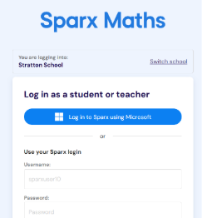
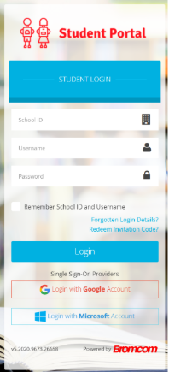
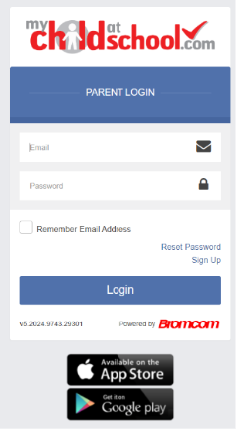
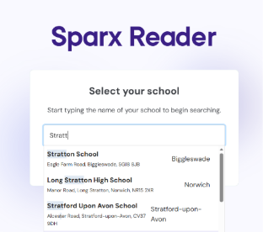


Supporting Home Learning
at Stratton School
At Stratton school we aim to ensure our students get the most from their education and high-quality homework plays an important role in this. Home learning provides several positive outcomes for students;
Providing opportunities for practise and consolidation of learnt material
Preparing for future lessons and assessments
Encouraging independent learning and study
How do I know what Homework has been set?
At Stratton, we use Bromcom to inform pupils of homework tasks.
Pupils can view their homework tasks and deadlines by using the Bromcom Student app which can be found online or downloaded as an app via the Google Play/Apple Store.
Parents are also able to view homework tasks via the MyChildAtSchool App (MCAS) which can be found online or downloaded as an app via the Google Play/Apple Store and is also available as a linked tab on our school website (MCAS parents).
Sparx - (Maths Year 7-11)
Homework is set every Wednesday and due the following Wednesday.
To log in pupils can search for “Sparx Maths” on any browser. Pupils will then need to select their school – Stratton School.
After this, pupils will be asked to log in. They can do this using their school login details by selecting “Log in to Sparx using Microsoft”.
Sparx Reader - (English Year 7 and 8)
Homework is set every Friday and due the following Friday.
To login pupils can search for “Sparx Reader” on any browser.
Once they have selected Stratton school, they can then use ‘log in with Microsoft’
Tassomai (Science Year 7-11, English/Geography/ History Year 9-11)
Homework can be completed anytime between Monday and Sunday.
Pupils are given a weekly goal to complete.
To log in pupils can search for “Tassomai” on any browser.
Pupils can then login by using their school login details by selecting “Microsoft”.
Soundtrap (Music Year 8-11)
To log in pupils can search for “Soundtrap” on any browser.
After this, pupils will be asked to log in. They can do this by using their school login details by selecting “Microsoft”.
Language Nut (Languages Year 7-11)
To log in pupils can search for “Languagenut” on any browser.
Log in using their Languagenut login details. If these are forgotten email gzarate@stratton.school or visit C3 (Mr Zarate’s room)
In the writing tasks, some words need special foreign characters. Copy the Web address here with a guide on how to type special characters in languagenut https://help.languagenut.com/article/290-student-guide-for-writing-tasks

Slide 2
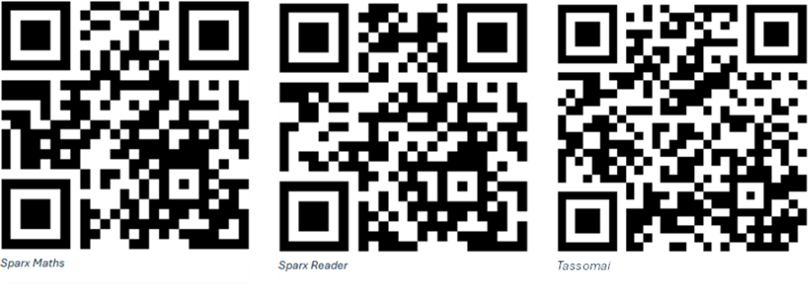

For further information on the previous platforms, please scan the QR codes below. For other subjects, staff will explain how to log in to the online platform used.
If you have any subject-specific questions, please contact your child’s teacher directly.
Parent Guide: Tracking Student Progress
Sparx Maths
Weekly Automated Emails: Parents receive a weekly update email detailing whether the current week's homework is completed, showing countdown timers to deadlines, and highlighting any outstanding tasks from prior weeks.
The Parent Portal: Every weekly email contains a secure, unique link to a live online portal. Clicking this gives parents real-time visibility into their child's current homework status, tracking data, and overall completion history without needing a password.
Sparx Reader
As above Book Completion Emails: Every time a student successfully finishes an e-book on Sparx Reader, an automated celebratory email is sent to the parent. This message shares how many points the student earned and includes conversation starters or suggested questions to help parents talk with their child about the book they just finished.
Languagenut
Using the Student Login Together: Many parents choose to log in using their child's school username and password. Sitting down together allows you to look directly at their completed assignments, saved scores, and the leaderboard to see how they are doing.
Seneca
Parent Dashboard & Reports: Parents can log in on the parent dashboard to view a comprehensive breakdown of study time (tracked by day and subject), average scores, and how performance compares to previous weeks.
Assignments Tracker: Displays all current, upcoming, and overdue homework tasks set by the school, along with a preview of the questions.
At Stratton school we believe in a shared responsibility when it comes to home learning.
Tassomai
Weekly Email Reports: Parents receive regular email summaries outlining how much work their child has completed, whether daily goals have been met, and overall answer accuracy.
Parent Dashboard & App: Parents can log into the Tassomai Parent Dashboard via web browser or the mobile app to check daily targets, time spent, accuracy rates, and the number of days since the student last logged in.
The Tree / Understanding Grid: A visual, color-coded feature mapping out student strengths and weaknesses across various topics, allowing parents to instantly see which specific areas need more revision or practice.

